Slide 1
Voice to Parliament
An introduction and information guide about the referendum to change the Australian Constitution and establish a First Nations Voice enshrined in the Constitution
Prepared by the Creative Ministries Network Congregation of the Uniting Church: http://creative.unitingchurch.org.au.
Program Co-Ordinator: John Bottomley
Contact: johnbottomley@netspace.net.au
Research and Design: Barry Mitchell and Jenni Mitchell

Slide 2
Uluru Statement from the Heart An Invitation from Australia’s First Nations
“Sovereignty is a spiritual notion: the ancestral tie between the land and our people.
This link is the basis of the ownership of the soil. It has never been ceded or extinguished, and co-exists with the sovereignty of the Crown.
How could it be otherwise? That peoples possessed a land for 60 millennia, and this sacred link disappears from world history in merely the last 200 years?
We seek constitutional reform to empower our people and take a rightful place in our own country.
We call for the establishment of a First Nations Voice enshrined in the Constitution.
We invite you to walk with us in a movement of the Australian people for a better future.”

Slide 3
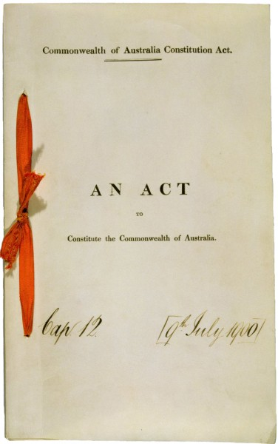
The Australian Constitution
The Australian Constitution has properly been described as ‘the birth certificate of a nation’. It also provides the basic rules for the government of Australia. Indeed, the Constitution is the fundamental law of Australia binding everybody including the Commonwealth Parliament and the Parliament of each State. Accordingly, even an Act passed by a Parliament is invalid if it is contrary to the Constitution. The Constitution was drafted at a series of conventions held during the 1890s and attended by representatives of the colonies. Before the Constitution came into effect, its terms were approved, with one small exception, by the people of New South Wales, Victoria, Queensland, Western Australia, South Australia, and Tasmania.
The Australian Constitution was then passed as part of a British Act of Parliament in 1900, and took effect on 1 January 1901. A British Act was necessary because before 1901 Australia was a collection of six self-governing British colonies, and ultimate power over those colonies rested with the British Parliament. In reality, however, the Constitution is a document which was conceived by Australians, drafted by Australians and approved by Australians.
Australian Government Solicitor, June 2020

Slide 4
What the Constitution covers
The underlying principles of the Australian Constitution explain how things work in the operation of the Commonwealth Government. The six foundation principles are democracy, the rule of law, the separation of powers, federalism, nationhood, and rights balanced by responsibilities.
The Constitution is divided into 8 chapters and 128 sections, the key features of which include:
an Australian Parliament comprising the House of Representatives and the Senate, the Executive Government, the Judiciary, and the 6 State governments, being responsible for national decision-making and law-making.
the High Court of Australia, which is the final court of appeal. The High Court interprets the Constitution and decides its meaning, as well as settling disputes between the Australian and State governments.
The Constitution does not cover all aspects of the governing of Australia. For example, the Prime Minister and the Cabinet are not mentioned in the Constitution. The Prime Minister and Cabinet operate by custom and tradition, similar to the British system from which they came.
The Constitution does not detail many of the rights of the Australian people. Unlike the Constitution of the United States, Australia's does not include a bill of rights. In Australia these rights are protected by common law (made by the courts) and statute law (written law made by Parliament).
At the time of Federation, Aborigines were excluded from the rights of Australian citizenship, including the right to vote, the right to be counted in a census and the right to be counted as part of an electorate.

Slide 5
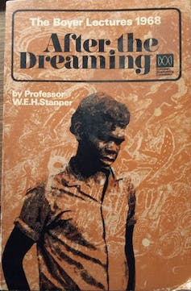
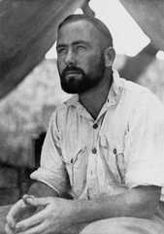
The first chapter of Australia’s history is missing from the Constitution. Our founding document makes no mention of the fact that Indigenous people were living here and caring for the land long before white settlement, and there is still no recognition that we are co-existing with the world’s oldest living culture.
Until 1967, Aboriginal people were not included in the population count. The Constitution still:
allows States to ban people from voting because of their race (S.25)
allows laws to be enacted to the detriment of Indigenous people (S.51 xxvi)
prohibits laws from being enacted to benefit Aboriginal people specifically

Slide 6
Changing the Australian Constitution
The Constitution can only be changed with the approval of the Australian people. A proposed change must be approved by the Parliament and then be voted on by Australians in a referendum.
A referendum is only passed if it is approved by a majority of voters in a majority of states, and by a majority of voters across the nation. This is known as a double majority.

Slide 7
Long Journey leading to Uluru:
Petition for Aboriginal Voice from William Cooper to King George V (1934)
First Bark Petition from Yolgnu people in Arnhem Land (1963)
Referendum to allow Fed Govt to count Aboriginal people (2 March 1967)
Govt purchases Gurindji country and hands back to traditional owners (Aug 1975)
High Court Mabo decision, wiping out terra nullius (3 June 1992)
Paul Keating Redfern Park speech acknowledging responsibility (10 Dec 1992)
Apology to the Stolen Generations by Kevin Rudd (13 Feb 2008)
Anthony Albanese commits Labor to a referendum (21 May 2022)

Slide 8
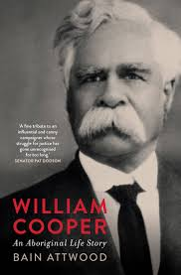
Petition for Aboriginal Voice from William Cooper to King George V
In 1934 William Cooper, Yorta Yorta elder and secretary of the Australian Aborigines’ League, sent a petition signed by 1,814 Aboriginal people to the Government asking the King to intervene to:
prevent the extinction of the Aboriginal race,
secure better conditions for all, and
afford Aboriginal representation in the Federal Parliament.
The Australian Cabinet reviewed the petition before deciding whether they would pass it on to the King. Because the federal parliament did not have the power to make a law for Aboriginal representation in parliament under the Constitution, they decided that ‘no good purpose would be gained by submitting the petition to his Majesty the King’. They recommended that ‘no action be taken.’
William Cooper’s petition is one example of the decades of First Nations activism that eventually led to the Uluru Statement’s call for Voice, Treaty, and Truth.

Slide 9
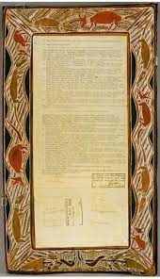
First Bark Petitions from Yolgnu people of Yirrkala in Arnhem Land
These are the first documents bridging Commonwealth law and the Indigenous laws of the land. These petitions from the Yolngu people of Yirrkala were the first traditional documents recognised by the Commonwealth Parliament and are thus the documentary recognition of Indigenous people in Australian law. Petitions to Parliament must conform to certain rules of procedure and the acceptance of these petitions marks a bridge between two traditions of law. There had been many earlier petitions from Aboriginal people to Australian parliaments, and attempts to present petitions to the Crown. These petitions are the first to use traditional forms and combine bark painting with text typed on paper. The painted designs proclaim Yolngu law, depicting the traditional relations to land and the typed text is in English and Gumatj languages. The petitioners unsuccessfully sought the Commonwealth Parliament's recognition of rights to their traditional lands on the Gove Peninsula in Arnhem Land through this instrument proclaiming those rights in traditional form. Though these documents did not achieve the constitutional change sought, they were effective in making a way for the eventual recognition of Indigenous rights in Commonwealth law.

Slide 10
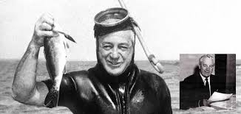
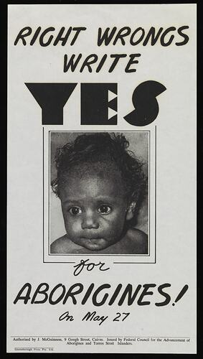
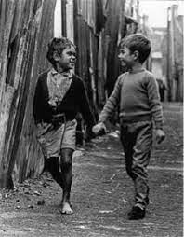
Referendum to allow Fed Govt to count Aboriginal people
The case for changes to the Australian Constitution to allow the Australian Government to legislate on behalf of First Australians, and for them to be counted in the national census, had been argued since the early 20th century.
In February 1967, Prime Minister Harold Holt announced that a referendum would be held asking the Australian people whether they were in favour of changing the Constitution. Members of FCAATSI, the Federal Council for the Advancement of Aborigines and Torres Strait Islanders, met with politicians on both sides of parliament to seek bipartisan support for the referendum.
In May 1967, an extraordinary 90.77% of voters voted in favour of changing the Constitution. It was the largest majority for any referendum in Australian history.

Slide 11
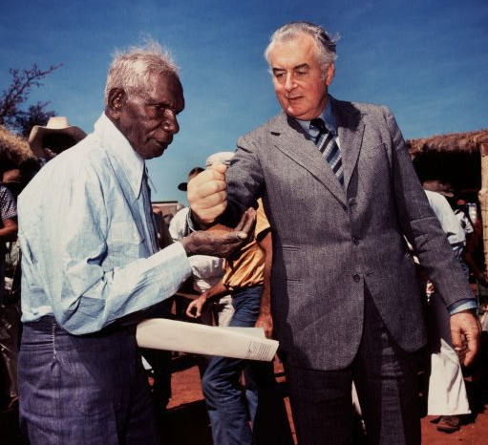
“These lands belong to the Gurindji people”
The historically significant gesture of pouring of a handful of red soil by Gough Whitlam into Vincent Lingiari’s hand on 16 August 1975, symbolised the legal transfer of Wave Hill station back to the Gurindji people. It also meant the Gurindji became the first Aboriginal community to have land returned to them by the Commonwealth Government and would be a turning point - the start of the Aboriginal land rights movement for the rest of Indigenous Australia, that continues even today. “Vincent Lingiari, I solemnly hand to you these deeds as proof, in Australian law, that these lands belong to the Gurindji people and I put into your hands part of the earth itself as a sign that this land will be the possession of you and your children forever,” Gough Whitlam said.
In response, Vincent Lingiari said:
"Let us live happily together as mates, let us not make it hard for each other... We want to live in a better way together, Aboriginals and white men, let us not fight over anything, let us be mates.”

Slide 12
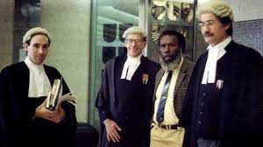
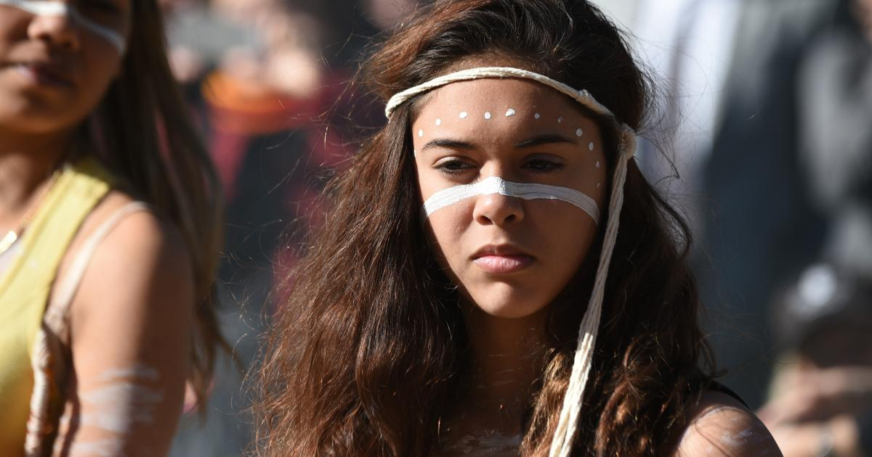
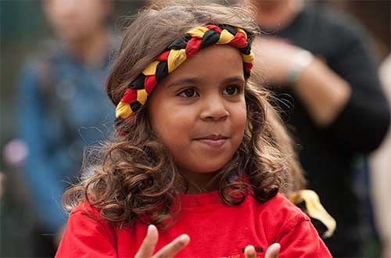
High Court Mabo decision, wiping out terra nullius
On 3 June 1992, the High Court of Australia handed down its landmark ruling on Mabo v Queensland No. 2 establishing the principle of native title rights in Australian common law.
The judgment overturned the concept of terra nullius – that Australia was a ‘land belonging to no-one’ at the time James Cook in 1770 declared possession in the name of the British Crown.
The case was led by Edward Koiki (Eddie) Mabo, plus 4 others, on behalf of the Meriam people of Dauer, Waier and Mer of the Murray Island Group in the Torres Strait, claiming ownership of their traditional lands.
It was the culmination of legal proceedings which began 10 years earlier when the plaintiffs had brought their first action against the State of Queensland and the Commonwealth claiming native title to the Murray Islands.
The Court found that the Meriam people continued to occupy the islands, as they had for generations before the first European contact and were ‘entitled as against the whole world to possession, occupation, use and enjoyment of the lands of the Murray Islands'.

Slide 13
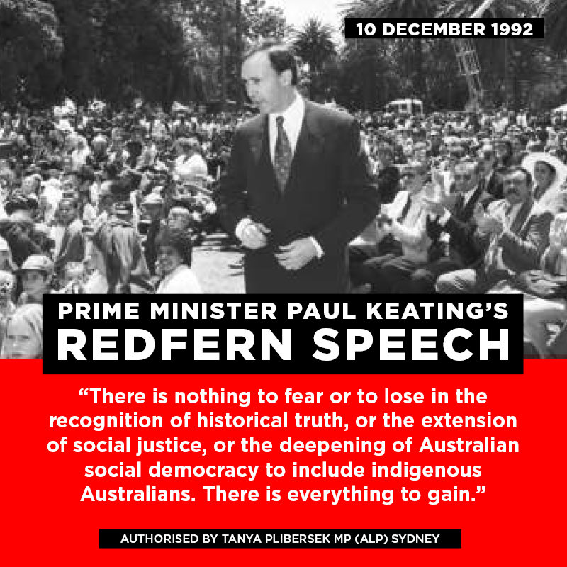
Paul Keating’s Redfern Park Speech – a moment in history
Few of those who were present were aware that they were witnessing history: A politician admitting that "we committed the murders", "we took the lands", "we brought the diseases" and "we took the children".
Prime Minister Paul Keating delivered the speech in Redfern Park on 10 December 1992, launching Australia's program for the International Year of the World's Indigenous People. The National Archives of Australia record the title of this speech as Opportunity and care, dignity and hope, 1993.
Keating delivered the speech 6 months after the High Court’s Mabo decision on native title.
Media did not give much attention to the speech at the time, but it is now regarded by many as one of the greatest Australian speeches.
www.creativespirits.info/aboriginalculture

Slide 14
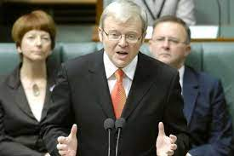
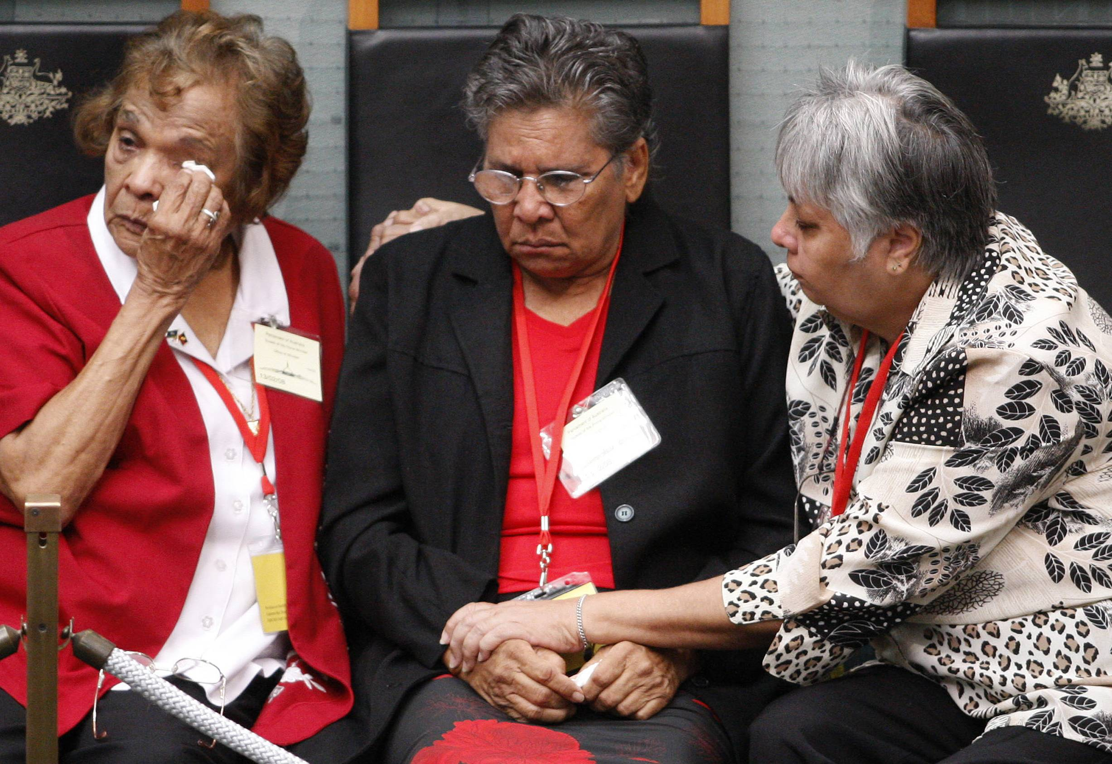
2008: Apology to the Stolen Generations by Kevin Rudd

Slide 15
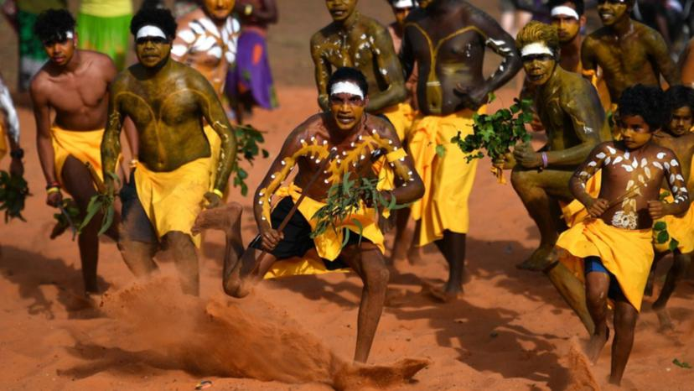
Garma Festival, Northern Territory, 30 July 2022

Slide 16
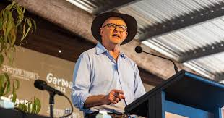
Extracts from Prime Minister Anthony Albanese’s speech at the Garma Festival, 30 July 2022
“The Uluru Statement is a hand outstretched, a moving show of faith in Australian decency and Australian fairness from people who have been given every reason to forsake their hope in both.
I am determined, as a government, as a country, that we grasp that hand of healing, we repay that faith, we rise to the moment.
To work with you in lifting the words off the page and lifting the whole nation up: with a new spirit of partnership between government and First Nations people, through the work of Makarrata, treaty-making and truth-telling, and by enshrining a Voice to Parliament in the Constitution.”

Slide 17
Enshrining a Voice in the Constitution
“Enshrining a Voice in the Constitution gives the principles of respect and consultation, strength and status. Writing the Voice into the Constitution means a willingness to listen won’t depend on who is in government or who is Prime Minister .
The Voice will exist and endure outside of the ups and downs of election cycles and the weakness of short-term politics. It will be an unflinching source of advice and accountability. Not a third chamber, not a rolling veto, not a blank cheque. But a body with the perspective and the power and the platform to tell the government and the parliament the truth about what is working and what is not.
I would like us to present the Australian people with the clearest possible referendum question. We should consider asking our fellow Australians something as simple as: Do you support an alteration to the Constitution that establishes an Aboriginal and Torres Strait Islander Voice? A straightforward proposition. A simple principle. A question from the heart.”
PM Anthony Albanese, Garma Festival, 30 July 2022

Slide 18
The Referendum Question
The question Australians will be asked to vote on is:
A proposed law: to alter the Constitution to recognise the First Peoples of Australia by establishing an Aboriginal and Torres Strait Islander Voice.
Do you approve this proposed alteration?
If this is passed by a majority of people and a majority of States, three clauses will then be inserted into the Australian Constitution. The wording of these clauses was agreed to by the First Nations Working Group on 23 March 2023, and is as follows:
There shall be a body, to be called the Aboriginal and Torres Strait Islander Voice.
The Voice may make representations to the Parliament and the executive government of the Commonwealth on matters relating to Aboriginal and Torres Strait Islander peoples.
The Parliament shall, subject to this Constitution, have power to make laws with respect to matters relating to the Voice, including its composition, functions, powers and procedures.

Slide 19
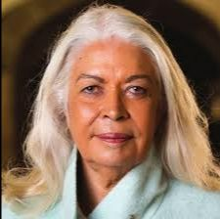
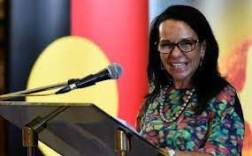
Recognising 65,000 years of human history - Marcia Langton “It is the duty of Australians who want to build a nation that recognises 65,000 years of human history, who want to accord First Peoples a rightful, honourable place in the nation’s fabric, in the warp and weft of its foundational document, to convince their family members, friends, neighbours and colleagues to vote “Yes”. We have asked people to imagine the days after the referendum when the votes are counted: Will our nation continue to be founded on colonial theft and brutality towards Indigenous people, or will its people agree to a new accord, one based on the right to dignity for all? There is something the NO camp doesn’t understand – or if they do, they are worse than I think. We will never get this opportunity again. This referendum is a once-in-many-lifetimes event. That is why it is more important than the cynicism and redneck opportunism with which they have tried to frame it.”
Prof. Marcia Langton
Hon Linda Burney, Minister for Indigenous Australians

Slide 20
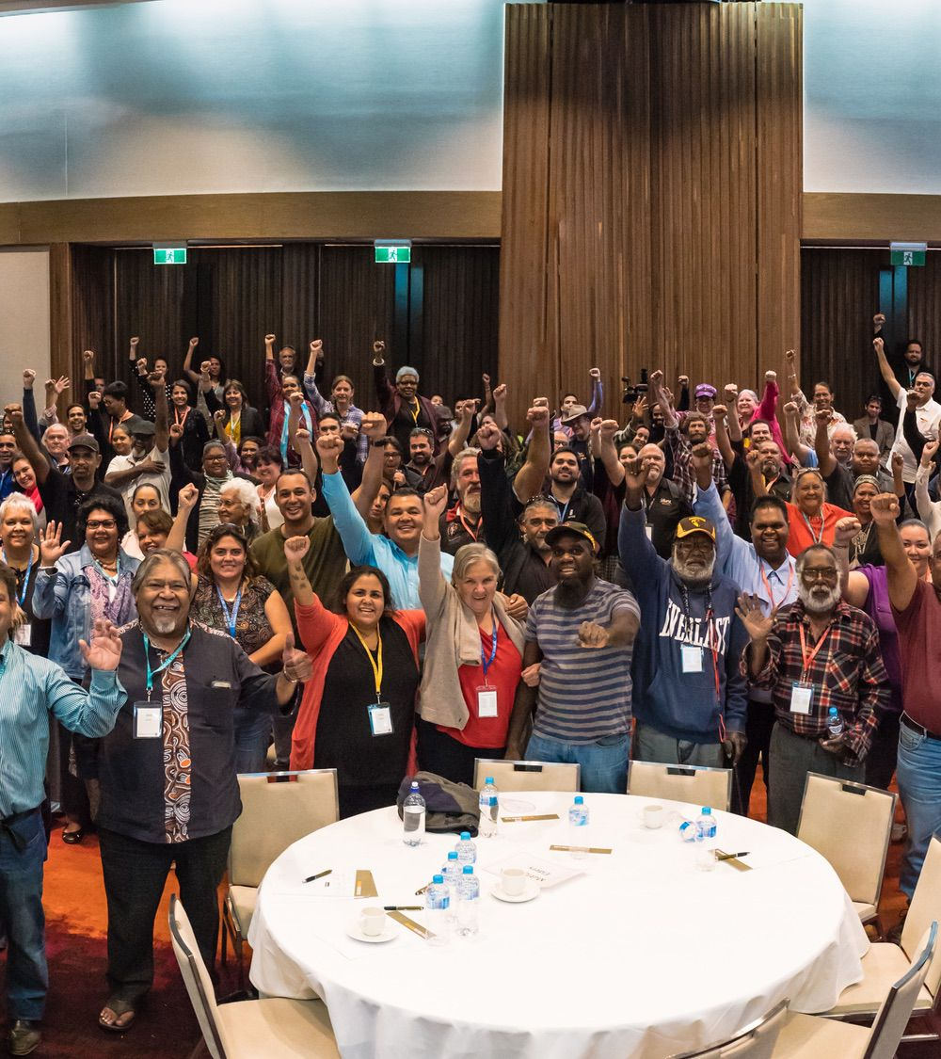
After the Referendum
“Makarrata” is the culmination of our agenda: the coming together after a struggle. It captures our aspirations for a fair and truthful relationship with the people of Australia, and a better future for our children based on justice and self-determination.”
“We seek a Makarrata Commission to supervise a process of agreement-making between governments and First Nations, and truth-telling about our history.”
“In 1967 we were counted. In 2017 we seek to be heard.”
“We invite you to walk with us in a movement of the Australian people for a better future”
Uluru Statement from the Heart

Slide 21
Reflections for your congregation
Recall the various slides in the powerpoint presentation. Become aware of the slide that most holds your attention. What is its message to you? Then reflect on what God may be saying to you through this message. Take 3-5 minutes in silence for this reflection.
Invite those participating in this study to take it in turns to share their reflection. Please do not interrupt or comment on other people’s reflections. When everyone who wishes to share their reflection has done so, discuss together what has emerged for you. Then discuss, What have you learned about the Uluru Statement from listening to one another?
What have you learned as a group about the Uluru Statement that is important for your faith? Take a moment in silence to reflect on this question and then share your responses in turn.
Recall a Bible verse or Bible story that sums up how this conversation has related your faith to the Uluru Statement from the Heart.
Conclude with a blessing.

